Slide 1

Customer Shopping Behavior Analysis
Uncovering insights from transactional data to guide strategic business decisions.

Slide 2


Project Overview & Data
Project Goal
Key Features
Analyze 3,900 purchases to optimize operations.
Demographics, purchase details, shopping behavior.
Missing Data
37 values in Review Rating column.

Slide 3


Exploratory Data Analysis (Python)
01
02
03
Data Loading & Exploration
Missing Data Handling
Column Standardization
Pandas for import, df.info(), .describe() for summary.
Imputed Review Rating with median by category.
Renamed columns to snake_case for readability.
04
05
Feature Engineering
Database Integration
Created age_group and purchase_frequency_days.
Loaded cleaned data to PostgreSQL for SQL analysis.

Slide 4
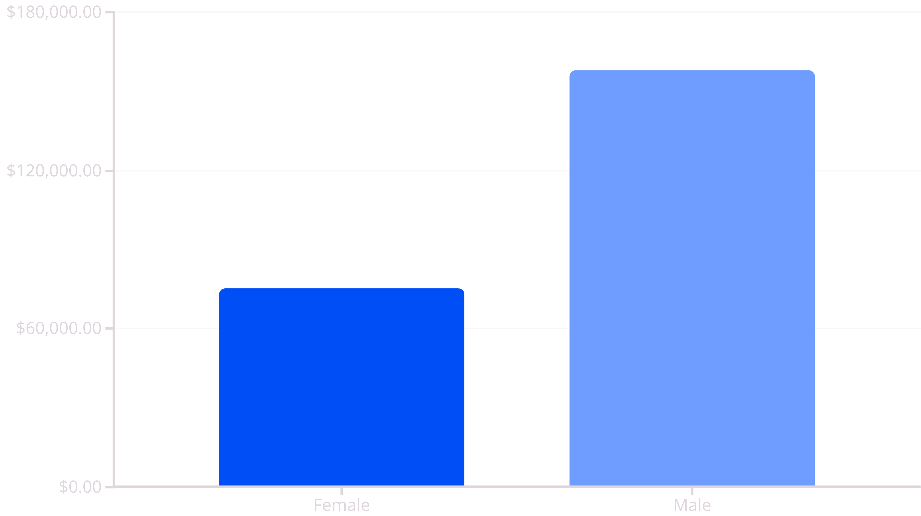
Revenue by Gender
Male customers generate significantly higher revenue.

Slide 5
Top Products & Shipping
Top 5 Products by Rating
Shipping Type Comparison
Gloves
3.86
Standard
58.46
Sandals
3.84
Express
60.48
Boots
3.82
Express shipping users have slightly higher average spend.
Hat
3.80
Skirt
3.78

Slide 6
Subscription & Discount Insights
Subscribers vs. Non-Subscribers
Discount-Dependent Products
Yes
1053
59.49
62645
Hat
50.00
No
2847
59.87
170436
Sneakers
49.66
Non-subscribers contribute more total revenue.
Coat
49.07
Sweater
48.17
Pants
47.37
Hats and Sneakers are most frequently discounted.

Slide 7
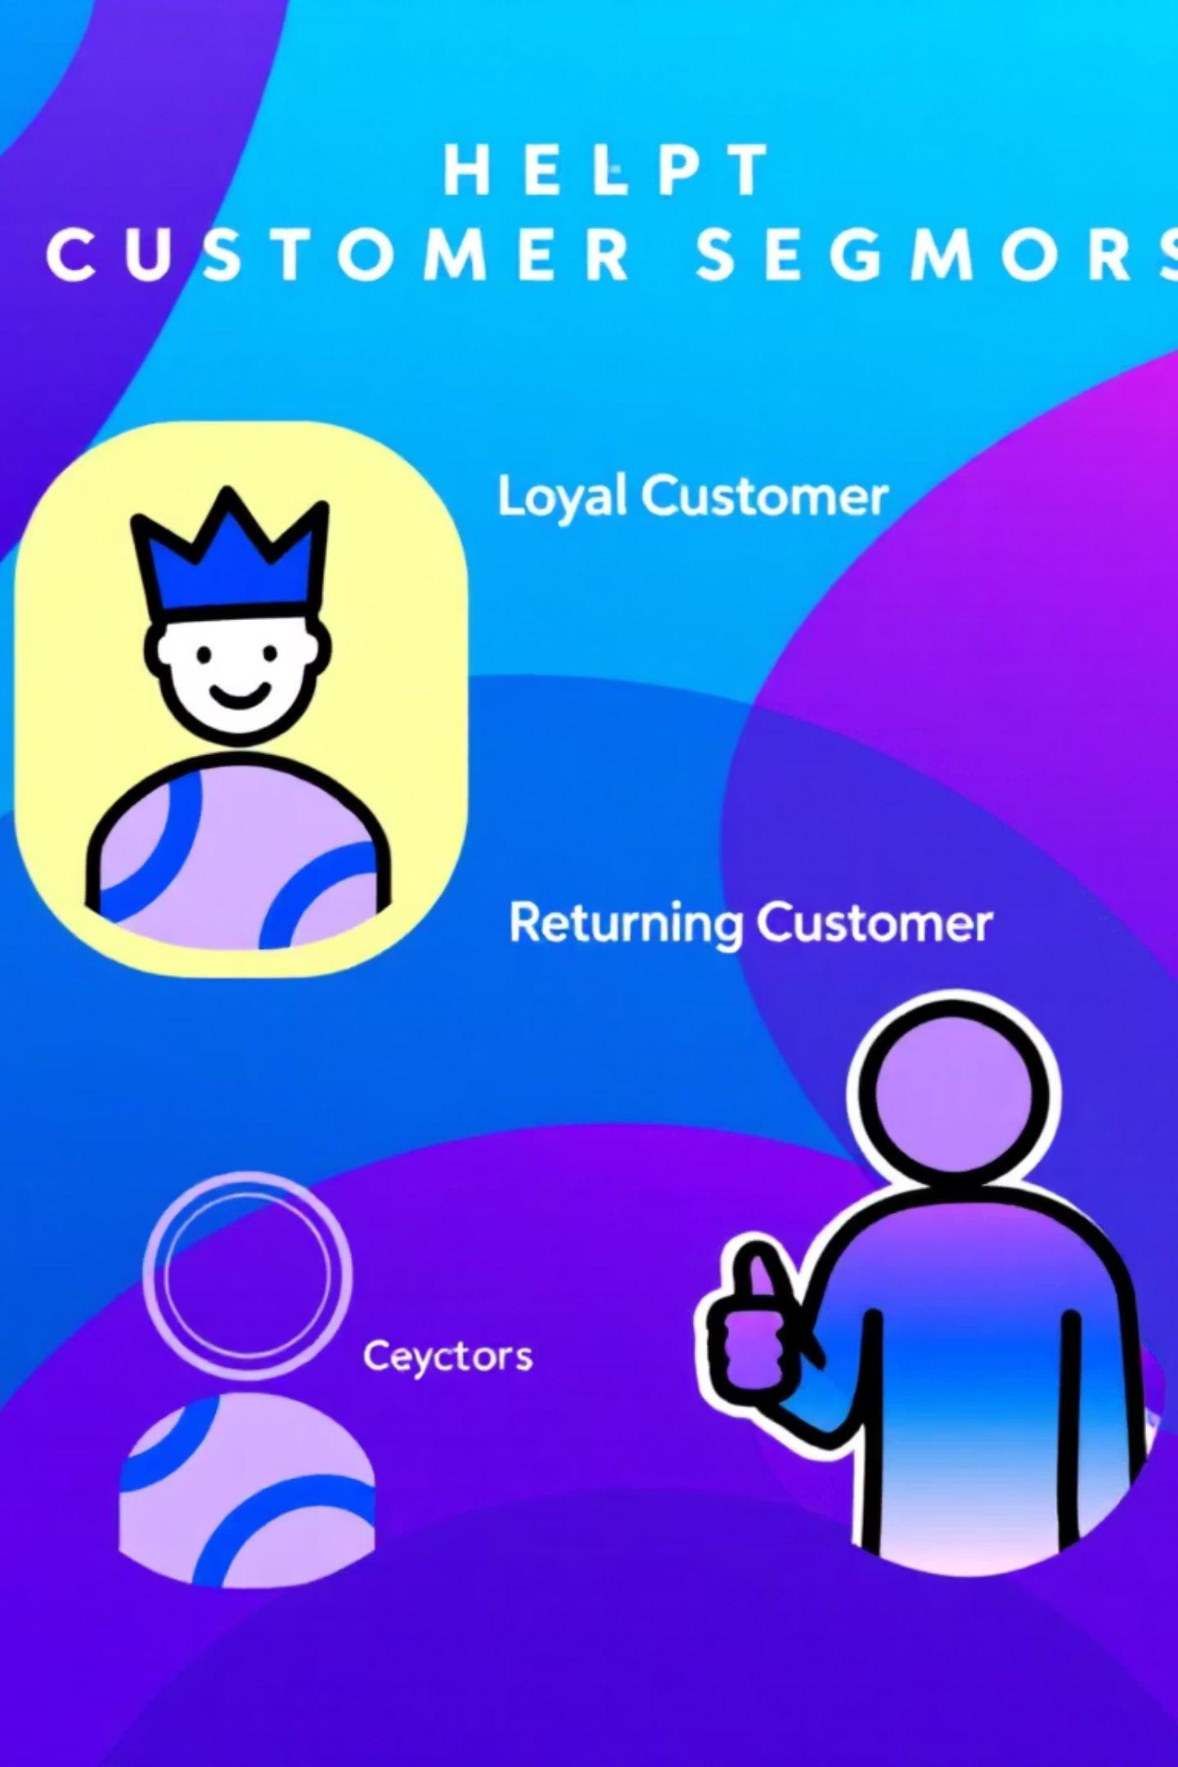




Customer Segmentation
Loyal
New
3116 Customers
83 Customers
Returning
701 Customers
Majority of customers are loyal, but new and returning segments need growth strategies.

Slide 8
Top Products Per Category
1
Accessories
Jewelry
171
2
Accessories
Sunglasses
161
3
Accessories
Belt
161
1
Clothing
Blouse
171
2
Clothing
Pants
171
3
Clothing
Shirt
169
1
Footwear
Sandals
160
2
Footwear
Shoes
150
3
Footwear
Sneakers
145
1
Outerwear
Jacket
163
2
Outerwear
Coat
161

Slide 9
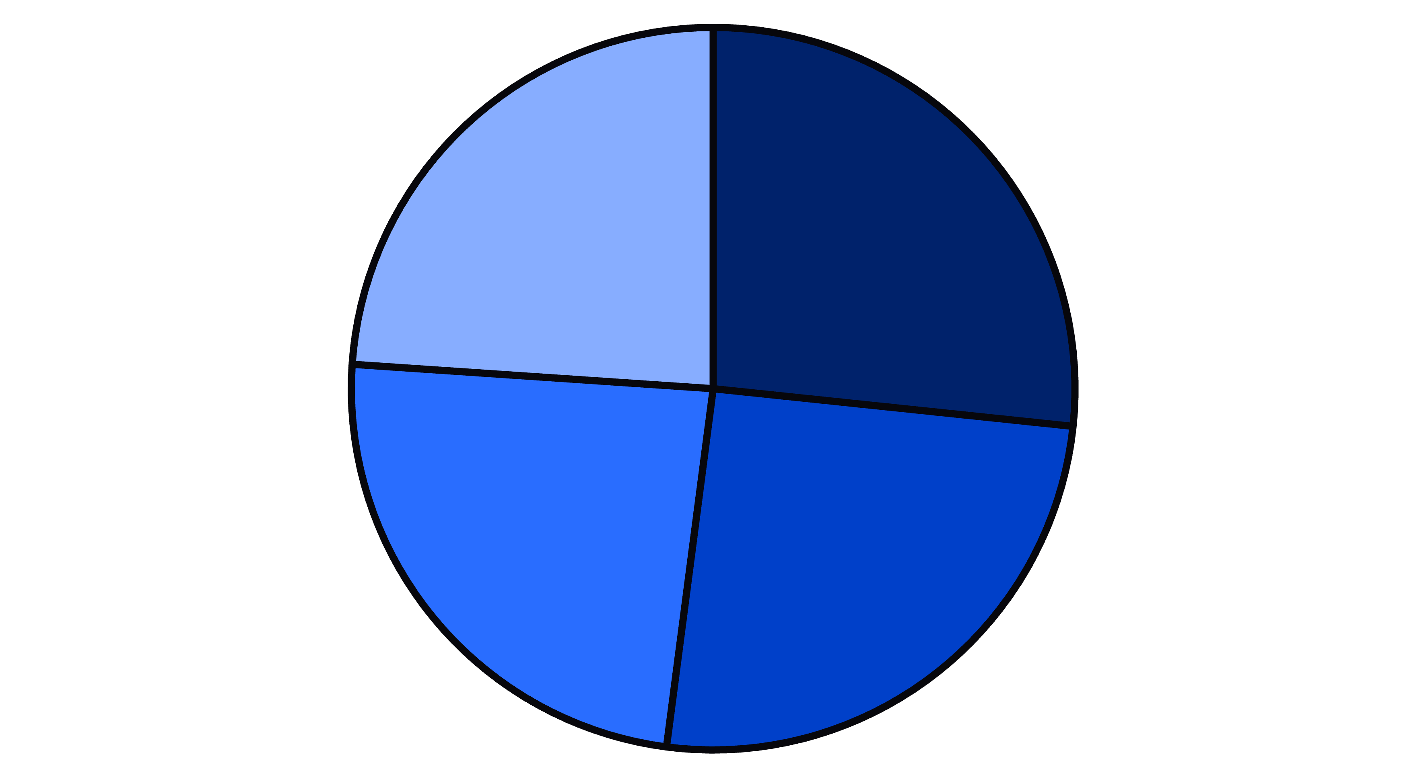
Revenue by Age Group
Young Adult
Middle-aged
Adult
Senior
Young Adults contribute the highest revenue.

Slide 10
Business Recommendations
Boost Subscriptions
Promote exclusive benefits for subscribers.
Customer Loyalty Programs
Reward repeat buyers to foster loyalty.
Review Discount Policy
Balance sales boosts with margin control.
Product Positioning
Highlight top-rated and best-selling products.
Targeted Marketing
Focus on high-revenue age groups and express-shipping users.

